Slide 1
Figure materials for PhD thesis

Slide 2
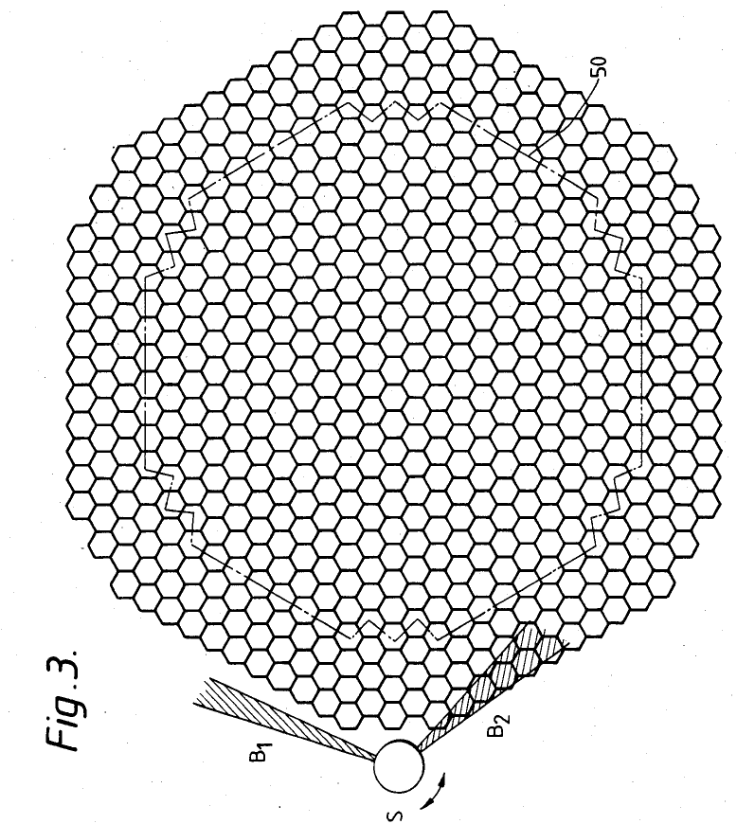

Slide 4
heat exchanger
core assembly
sodium flow

Slide 5
(A)
(B)
(C)
(D)

Slide 6
(A)
(C)
(B)
400℃
Temperature field
600℃
(D)
20
22.00
0.00℃
0℃

Slide 7
(A)
(B)

Slide 8
(A)
(B)
400 ℃
300 ℃
180 ℃
0.08m
0.08m
190 ℃
-0.08m
0.08m
-0.08m
-0.08m

Slide 9
(A)
(B)
(C)
Upper core region

Slide 10
(A)
(B)

Slide 11
(A)
(A.1-1)
(A.1-2)
0.00 m/s
5.00 m/s
0.00 m/s
1.90 m/s
(A.2-1)
(A.2-2)
540 ℃
565 ℃
545 ℃
565 ℃
(B)
(B.1-1)
(B.1-2)
0.00 m/s
5.00 m/s
0.00 m/s
3.00 m/s
(B.2-1)
(B.2-2)
540 ℃
565 ℃
552 ℃
559 ℃

Slide 12
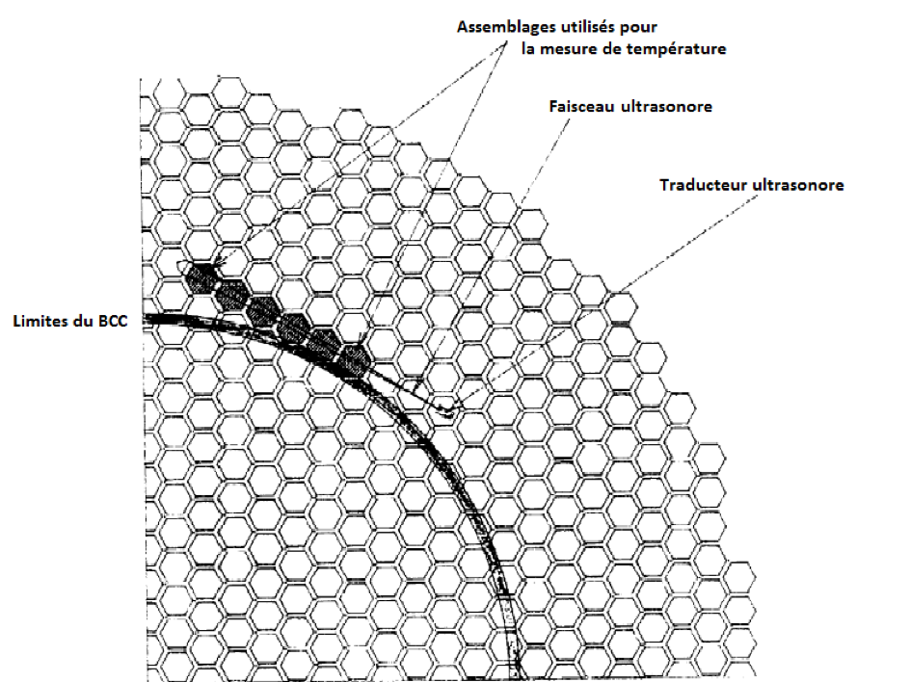
Subassemblies used for temperature measurement
Acoustic beam
Acoustic transducer
Limit of
core cover plate

Slide 14
DNS
LES
RANS

Slide 15
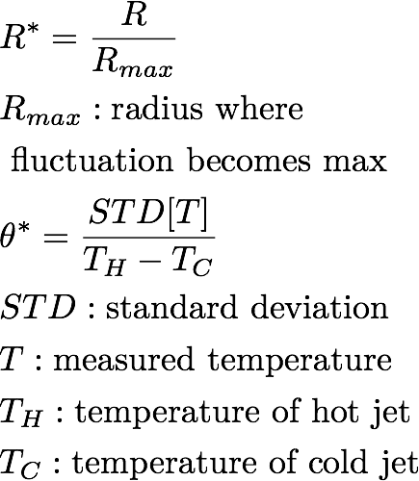

Slide 17
(A)
(C)
(D)
(B)
kobayashi 2015

Slide 18
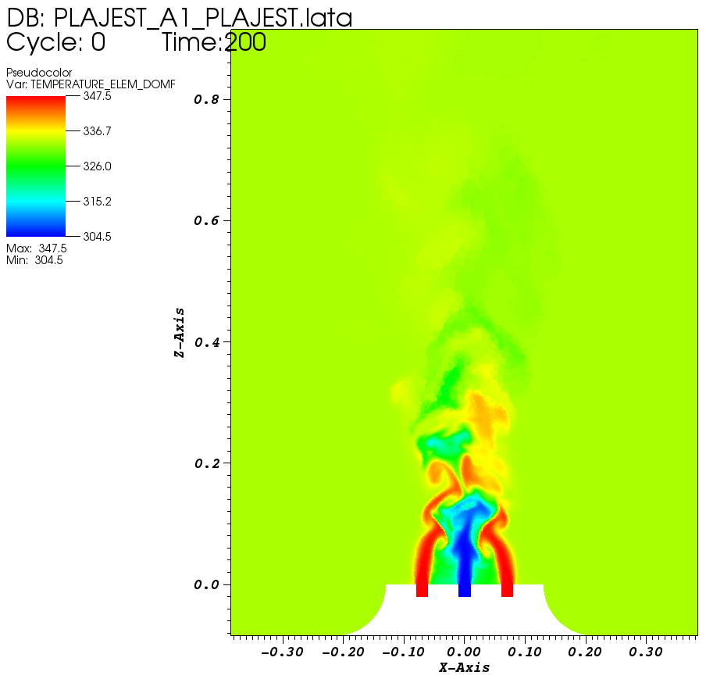
(A)
(B)
(C)
(D)

Slide 19
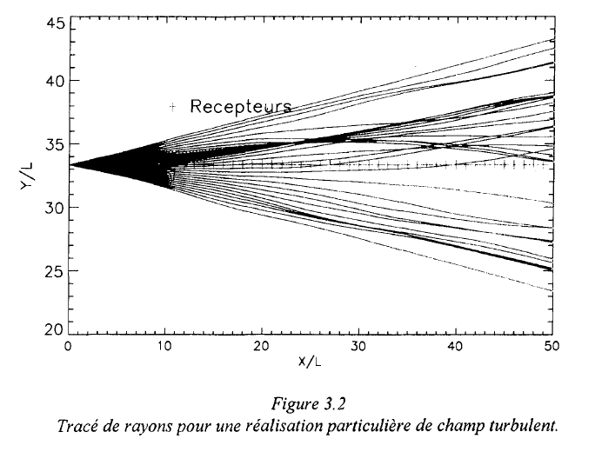
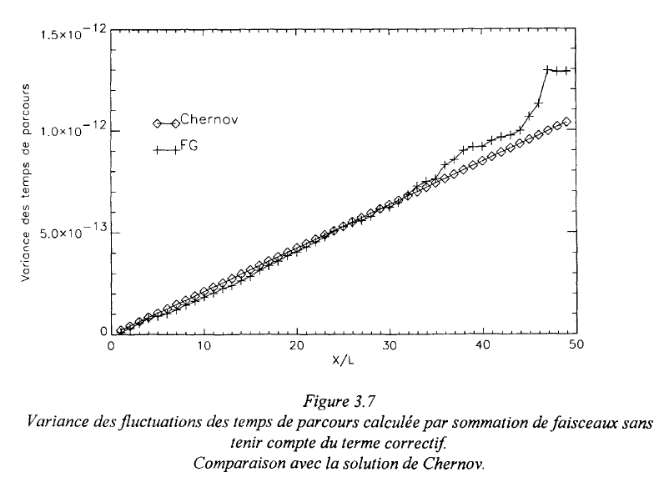
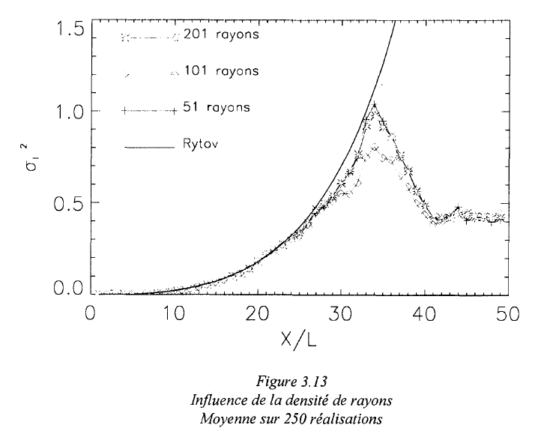
(A)
(B)
(C)

Slide 20
(A)
Temperature field
Velocity field
(B)
Sound celerity field
2.0 m
1.0 m
1.0 m
6.0 m
1.0 m
1.0 m
1499.76
1517.78 m/s
15.4556
45.2595 ℃

Slide 21
(A)
(B)

Slide 22
(A)
(B)
(C)

Slide 23
(B)
(D)
(A)
Config. 90 deg.
Config. 45 deg.
(C)
(E)

Slide 24
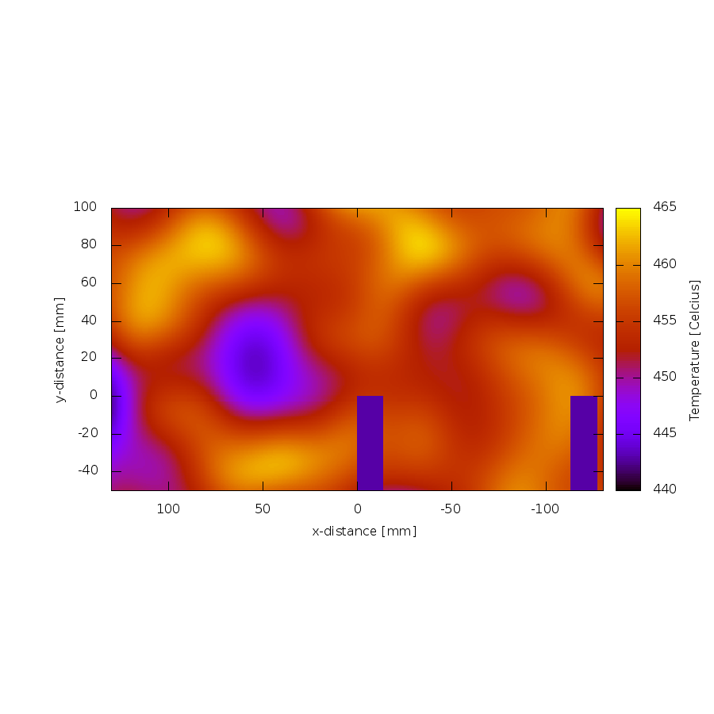
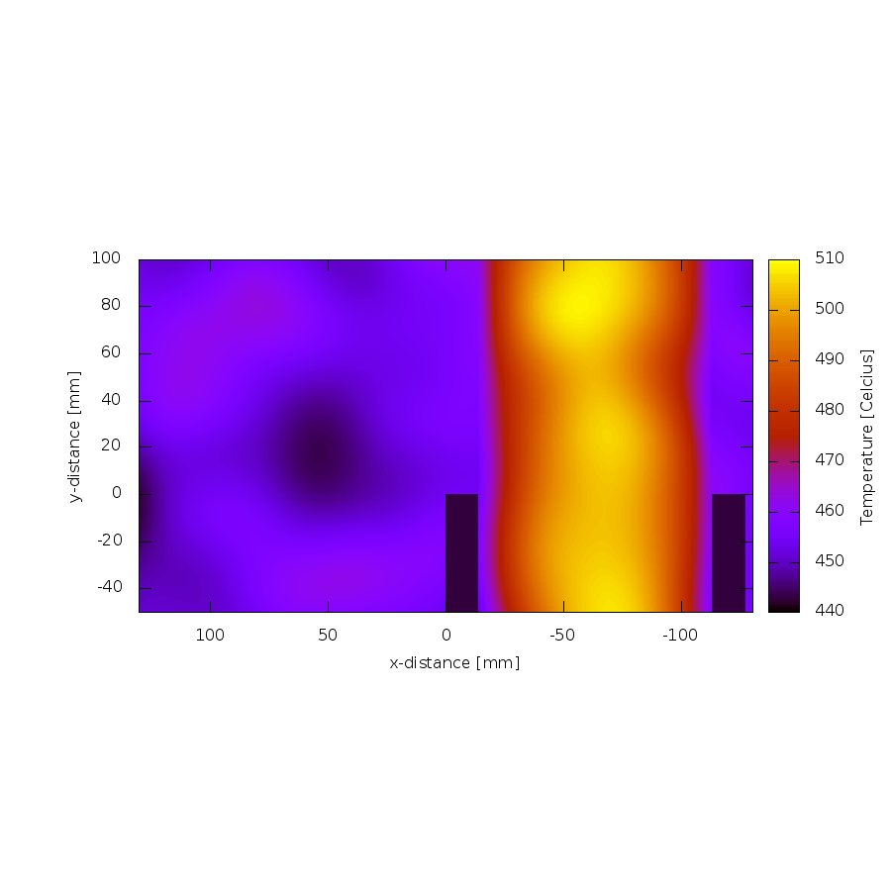
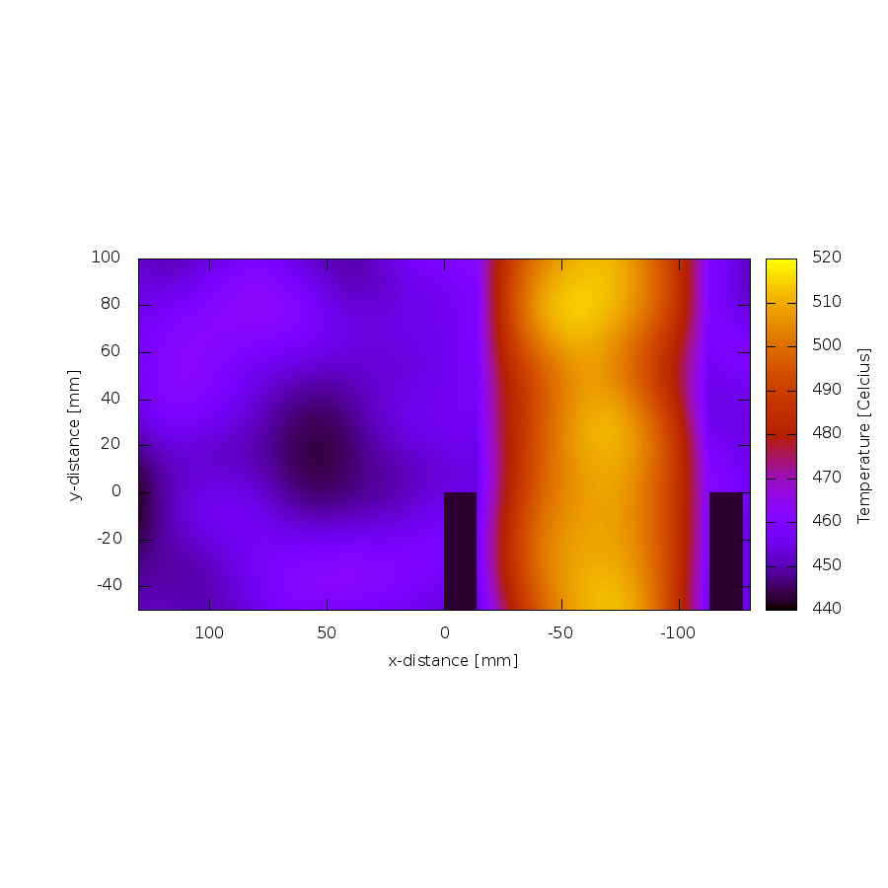

(a)
(b)
(c)
(d)

Slide 25
results for chapter 4

Slide 26
1) z alt 0.04, x 0.105
2) z alt 0.09, x 0.105
3) z alt 0.13, x 0.105
4) z alt 0.21, x 0.105

Slide 27
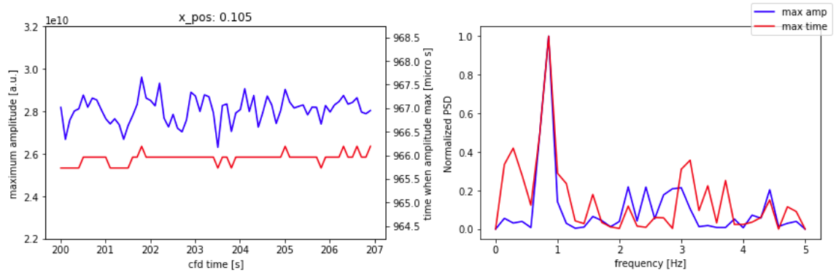
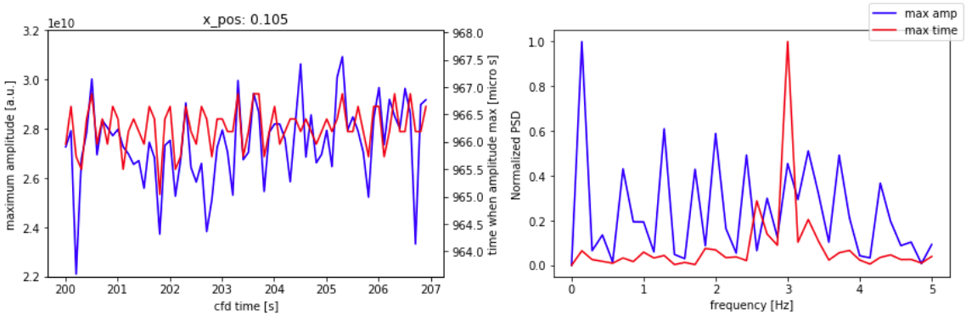
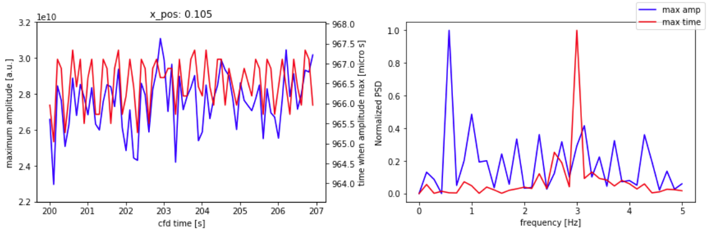
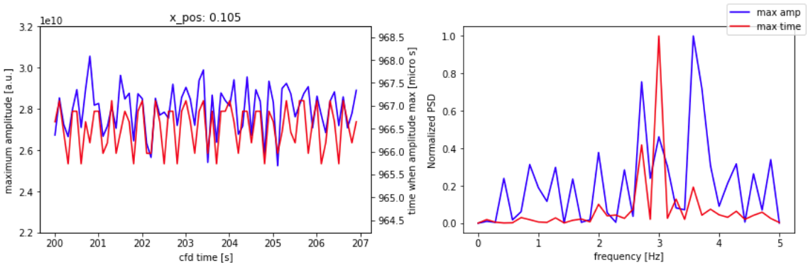
1) z alt 0.04, x 0.105
2) z alt 0.09, x 0.105
3) z alt 0.14, x 0.105
4) z alt 0.21, x 0.105

Slide 28
A
B
C
D

